Slide 1
Empathetic Dialogue Systems
共情对话系统
Sahand Sabour (山姆)
ID: 2022380024
Department of Computer Science and Technology, Tsinghua University
Thesis Proposal for “How to report research results in English and Related Issues”
April 20th, 2023

Slide 2
List of Contents
Introduction and Background
Dialogue Systems
Empathy
Empathy in Dialogue Systems
Recent Work and Existing Problems
Aims and Motivations
Motivations
Expected Contributions
Research Plan

Slide 3
Introduction and Background

Slide 4




Dialogue Systems
What are Dialogue Systems?
AI programs that can simulate a human conversation.
Used to accomplish specific tasks (task-oriented) or normal daily conversations (open-domain).
Hey Siri!
I had so much fun today.
Sounds great! What did you do?
Watched a great movie!
I love movies!
Task-oriented
Open-domain

Slide 5
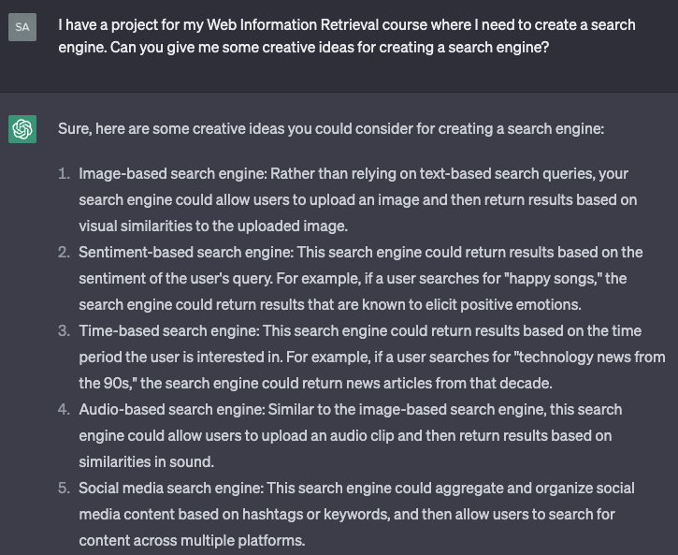

Dialogue Systems
ChatGPT: A blend of task-oriented and open-domain dialogue systems.

Slide 6
Empathy
As humans, we have the unique ability to express empathy towards others.
For instance, when other people tell us about their lives, we
Adopt their perspective of the situation.
Think about how we would feel if we were in their shoes (i.e., simulate their emotions).
We feel sad if our parents tells us that they lost their job.
We feel happy when our friend achieves their dream.

Slide 7



Empathy
It was adopted from the German word Einfühlung in 1986.
There is no globally-accepted definition of empathy [1].
Generally, empathy is considered a complex multi-dimensional construct with two aspects [2,3]:
Affect: Emotional simulation in reaction to the experience of others.
Cognition: Understanding the situation and its corresponding implications.
You must be really sad.
Affective Empathy
I got a low grade even though I studied a lot.
You must have tried your best.
Cognitive Empathy

Slide 8
Empathy in Dialogue Systems
The main objective of building dialogue systems is to model human behavior.
Therefore, It is necessary for human-like dialogue systems to have empathy.
Builds user trust and rapport.
Improves user satisfaction.
Helps understand user's emotions and feelings.
Important for emotional and mental health support.
Useful in real-world applications such as sentiment analysis, opinion mining, etc.
Empathy in Dialogue Systems

Slide 9
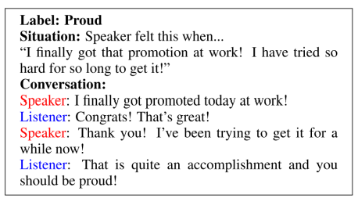
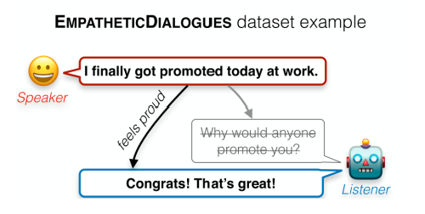
Empathy in Dialogue Systems
EmpatheticDialogues Dataset [4]
First attempt at implementing empathy in dialogue systems.
Empathy → understanding the user’s emotions and responding appropriately.

Slide 10



Recent Work and Existing Problems
We should generate responses based on how our users would feel towards them (emotion look-ahead).
We should train and mix experts for understanding user's emotions.
Shin et al. (2019) [5]
How about generating responses by mimicing the user's emotion to a degree?
Lin et al. (2019) [6]
We need external knowledge to understand emotions, right?
Majumder et al. (2020) [7]
Is emotion all we need?
Li et al. (2020) [8]

Slide 11
Aims and Motivations

Slide 12
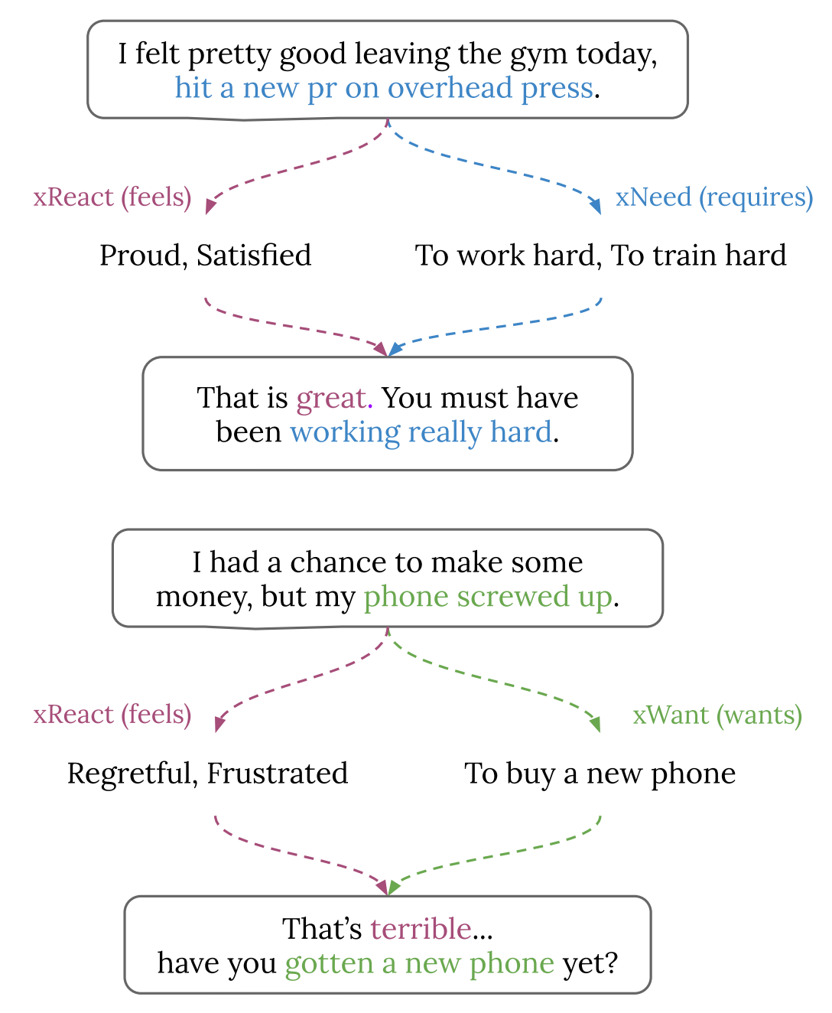
Motivations
Understanding the user's emotions only covers one aspect of empathy.
The user might not explicitly talk about their situation and feelings.
Humans use Commonsense to realize such implications → Not available to dialogue systems!

Slide 13
Motivations
There are text-based resources for commonsense knowledge.
ATOMIC: An atlas of everyday if-then commonsense inferences [9].
COMET: GPT-2 trained on ATOMIC for generating commonsense inferences [10].
We could also use GPT-3 or ChatGPT.

Slide 14
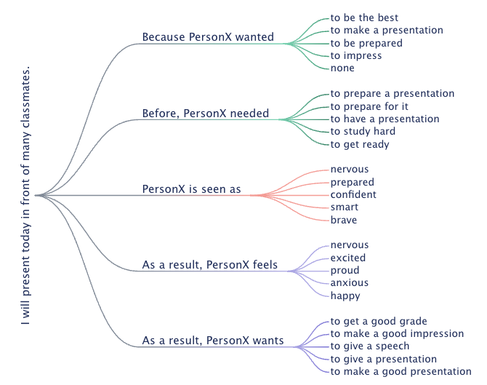
Motivations
Example of Commonsense Generation

Slide 15
Expected Contributions
We hypothesize that
Leveraging commonsense knowledge could help with understanding situational implications.
This would enable us to realize cognitive empathy in dialogue systems.
Having both affective and cognitive empathy leads to more empathetic dialogue systems.
Our Contributions will include
Creating a dialogue system that
Uses commonsense knowledge for cognitive empathy.
Fuses cognitive and affective empathy to generate more empathetic responses.
Conducting automatic and human evaluations that demonstrate our systems’ superior performance.

Slide 16
Research Plan
Objective | Start Date | Expected End Date | Status
Data collection | 2023-01 | 2023-02 | Complete
Literature Review | 2023-01 | 2023-06 | 60% complete
Model Creation | 2023-03 | 2023-06 | Not started
Automatic Evaluation | 2023-06 | 2023-07
Human Evaluation | 2023-06 | 2023-07
Paper Writing | 2023-07 | 2023-08

Slide 17
Thank You for Your Attention.
Any Questions?

Slide 18
References
[1] Stephen Turner, 2012. The Strength of Weak Empathy. Journal of Science in Context.
[2] Mark H Davis et al. 1980. A multidimensional approach to individual differences in empathy. Journal of Personality and Social Psychology.
[3] Sevgi Cos ̧kun Keskin. From what isn’t Empathy to Empathic Learning Process, 2014. Proceedings of Social and Behavioral Sciences.
[4] Rashkin, H., Smith, E., Li, M. Boureau, Y., 2019. Towards Empathetic Open-domain Conversation Models: A new benchmark and dataset. arXiv preprint arXiv:1811.00207.
[5] Shin, J. Xu, P., Madotto, A., Fung, P., 2019. HappyBot: Generating Empathetic Dialogue Responses by Improving User Experience Look-ahead. arXiv:1906.08487.
[6] Zandie, R., Mahoor, M., 2020. EmpTransfo: A Multi-head Transformer Architecture for Creating Empathetic Dialog systems. arXiv:2003.02958.
[7] Majumder, N., Hong, P., Peng, S., Lu, J., Ghosal, D., Gelbukh, A., Mihaleca, R., Poria, S., 2020. MIME: MIMicking Emotions for Empathetic Response Generation. arXiv:2010.01454.
[8] Li, Q., Chen, H., Ren, Z., Ren, P., Tu, Z., & Chen, Z. (2019). EmpDG: Multiresolution interactive empathetic dialogue generation. arXiv preprint arXiv:1911.08698.
[9] Sap, M., Le Bras, R., Allaway, E., Bhagavatula, C., Lourie, N., Rashkin, H., ... & Choi, Y. (2019, July). Atomic: An atlas of machine commonsense for if-then reasoning. In Proceedings of the AAAI conference on artificial intelligence (Vol. 33, No. 01, pp. 3027-3035).
[10] Bosselut, A., Rashkin, H., Sap, M., Malaviya, C., Celikyilmaz, A., & Choi, Y. (2019). COMET: Commonsense transformers for automatic knowledge graph construction. arXiv preprint arXiv:1906.05317.

